Slide 1
AXIS B8 INTERNAL PROJECT
UNDER THE GUIDANCE OF :
SYED SIR.
KUMARESH GUPTA SIR.

Slide 2

Sri Krishna Tours and Travels

Slide 3
Project Overview:
Tour Booking is an integrated software developed for tourism business. .It is a dynamic and responsive system and it addresses the challenges of managing the records ,missing records due to human errors. The purpose is to build a system that performs all operations related to travelling, booking, sightseeing. This system gives a variety of travel services.
In bookings we can get the tours booked by a particular customer and we can know the status of booking whether it was booked successfully or not.

Slide 4
Technologies and Tools Used:
Technologies | Tools
(Back-End) Java, Spring Boot Microservices, H2 Database (Front-End) HTML-5 CSS ,javascript, Bootstrap | IntelliJ Idea, postman, Visual Studio Code.
Database Requirements: Tour service: tour_id, tour_name, tour_cost, tour_days. Customer Service:customer_id,customer_name,customer_email,customer_phone,customer_city,customer_state,customer_country. Bookings Service:Booking_id,Booking_number,Booking_status,customer_id,tour_id

Slide 5
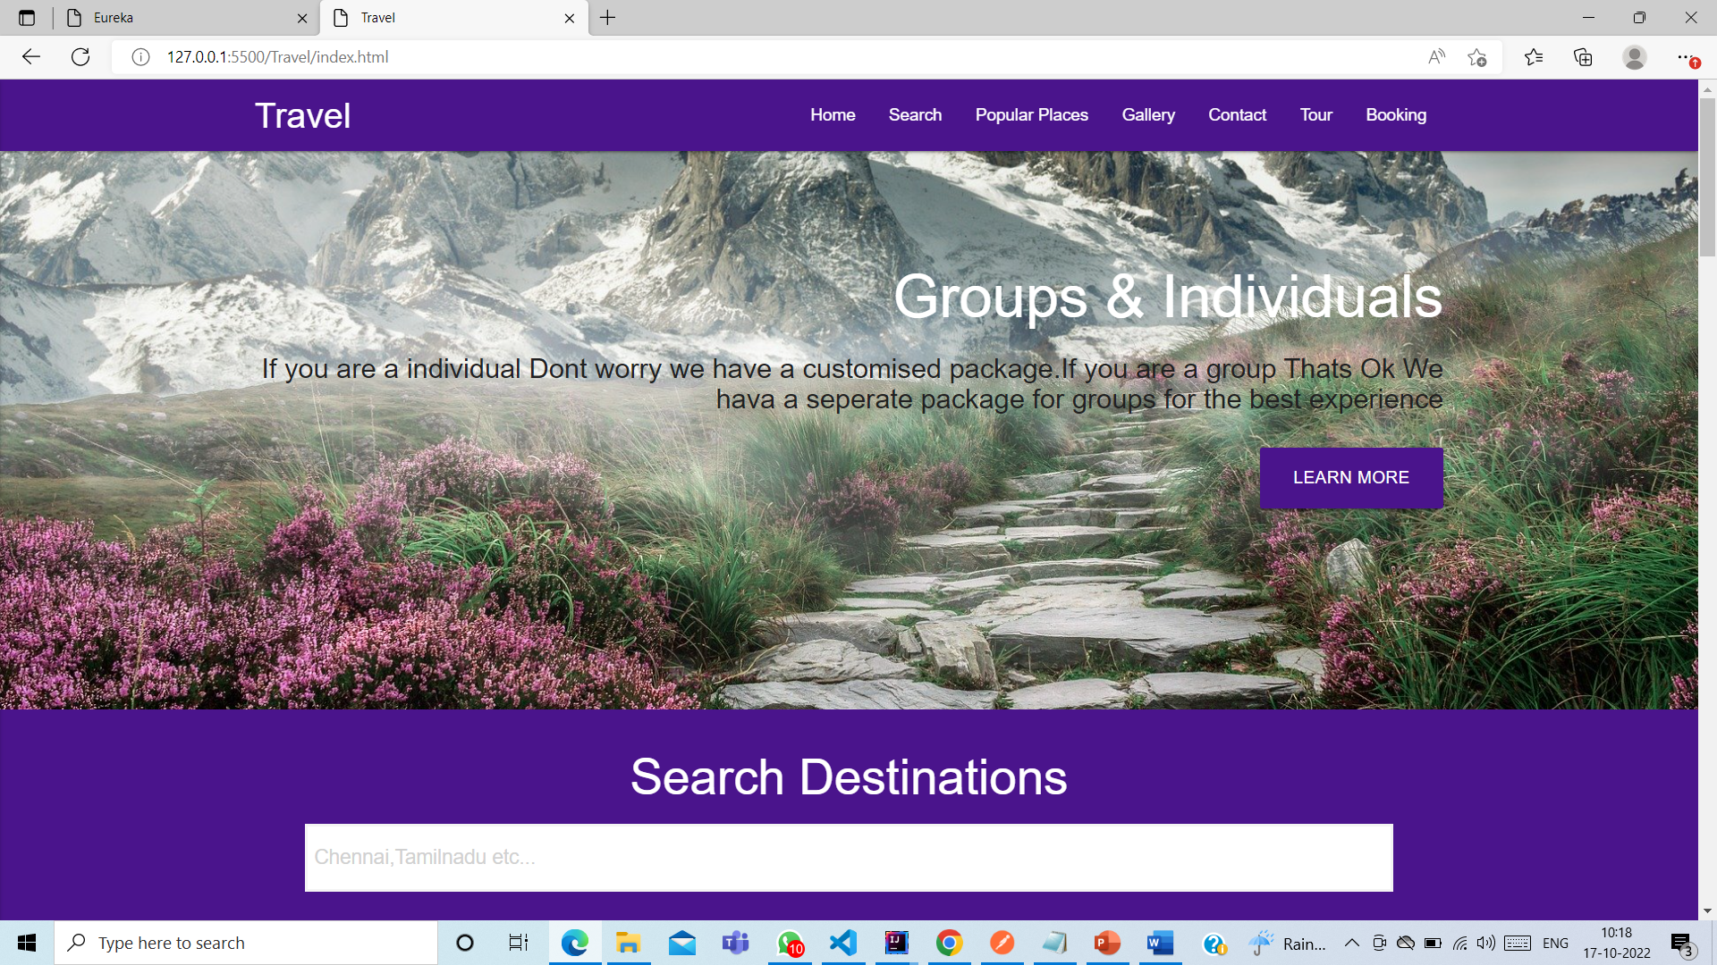
Results:

Slide 6
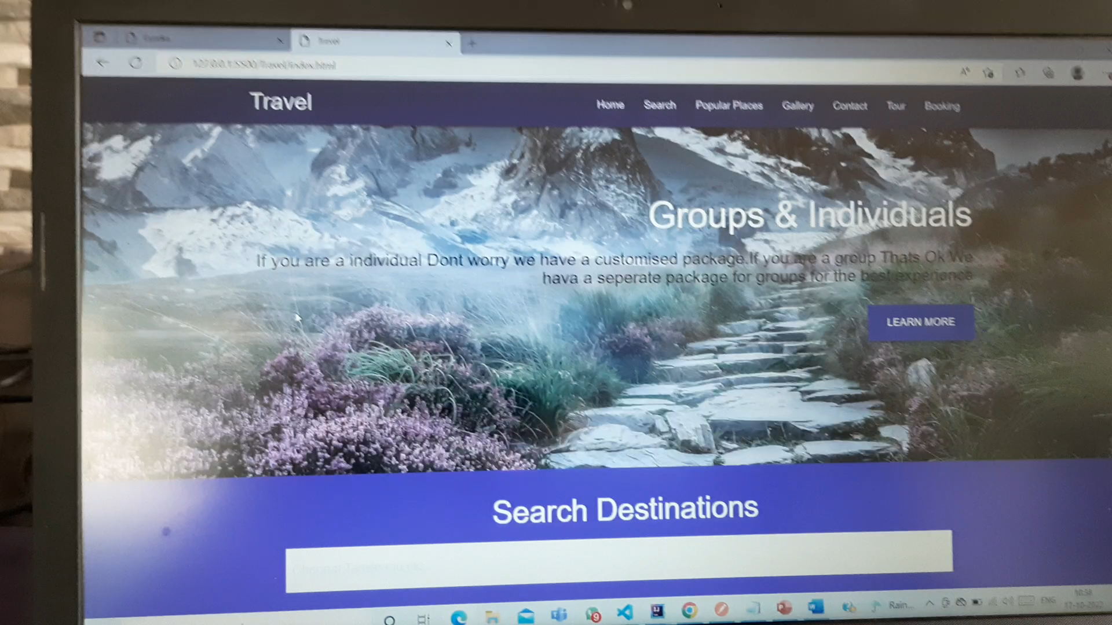
Walkthrough Video:

Slide 7


